Slide 1

Real Estate Sampling in Ames, Iowa (2006 - 2010)
Sudip Bhattacharyya & Dan Freeman

Slide 2
Task 1

Slide 3
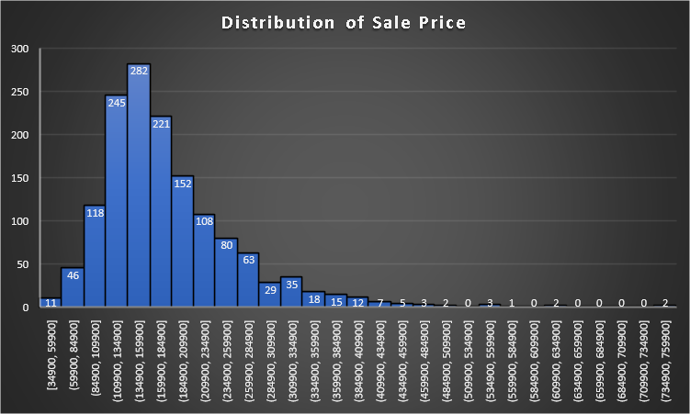
Objective & Dataset
Comparative study between different sampling designs in drawing sufficiently sized samples from population in order to obtain information on population characteristics.
Dataset
Dataset provides the house sale prices in 25 different neighborhoods of Ames, Iowa in between 2006 and 2010
Dataset contains 81 variables (categorical and continuous) across 1460 house-sales between 2006 and 2010
Variables cover the aspects such as Sale price, Zoning, Neighborhood, Lot size and character, Age of the property, House Style, Foundation, Total area, Number of rooms, Garage quality, Additional features etc.
Sampling designs focus on Neighborhood, House Style, Gross Living Area and Sale Price
Population Overview
Average sale price is parameter of interest
Population size (N) = 1,460
Average sale price for population (µ) = $180,921
Standard deviation of sale prices for population (σ) = $79,415
Sale price ranges from $35,000 to above $750,000
Over 50% of sales cost between $110,000 and $185,000
Sale price has right skewed distribution due to few high value sales

Slide 4
Sample Designs & Sample Size Determination
Consider four different sample designs in this study:
Simple Random Sampling
Stratified Sampling with proportional allocation
Stratified Sampling with Neyman allocation
Two Stage Sampling
With CLT and considering large sample size, assume Normality in population distribution despite observed skewness.
Margin of error = $10,000 (approximated 5% of average sale price in population)
Initial sample size:
n_{0,srs} = (z_{95%})² * s² / (I_{95%})² = (1.96)²*(79415)²/(10000)² = 242
Final sample size:
n_{srs} = n_{0,srs} / (1 + n_{0,srs} /N) = 242 / (1+ 242/1460) = 208
Consider sample size of 208 sample units/records for all four sampling methods irrespective of complexity of the designs.

Slide 5
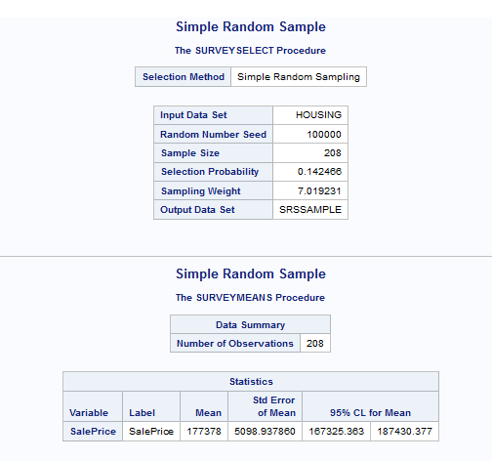
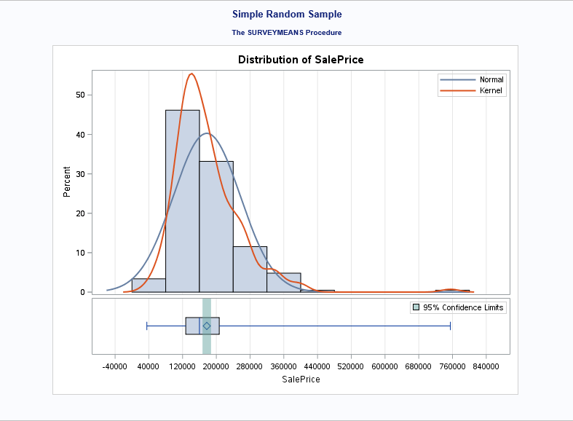
Design 1: Simple Random Sampling
Simple random sampling is a sampling design in which each sample unit is chosen randomly so that at any stage all the population units have the same probability of being chosen in the sample.
Sampling Results (Output from SAS)
Sample mean (x-bar) = 177,378
S.E of sample mean (s) = 5,099
95% C.I for sample mean = [167,325, 187,430]

Slide 6
Design 2: Stratified Sampling with Proportional Allocation
Stratified sampling is a technique followed when the population has several homogeneous subgroups, known as strata, and the sample is drawn in such a way that each stratum is representative of the population. A simple random sampling method is used to select sample units from each stratum. For a proportional allocation, sample units from each stratum maintain the same ratio of the number of units in each stratum in the population.
Stratum Sample Sizes
Stratum | House Style | No. Of Houses (Nh) | Proportion (ph) | Sample Size (nh)
Stratum 1 | 1 Story | 726 | 0.4973 | 103
Stratum 2 | 1.5 Fin | 154 | 0.1055 | 22
Stratum 3 | 1.5 Unf | 14 | 0.0096 | 2
Stratum 4 | 2 Story | 445 | 0.3048 | 64
Stratum 5 | 2.5 Fin | 8 | 0.0055 | 1
Stratum 6 | 2.5 Unf | 11 | 0.0075 | 2
Stratum 7 | Sfoyer | 37 | 0.0253 | 5
Stratum 8 | SLvl | 65 | 0.0445 | 9
Total |  | 1460 |  | 208

Slide 7
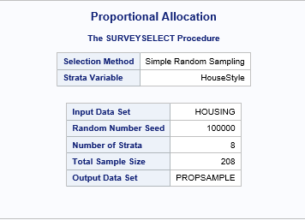
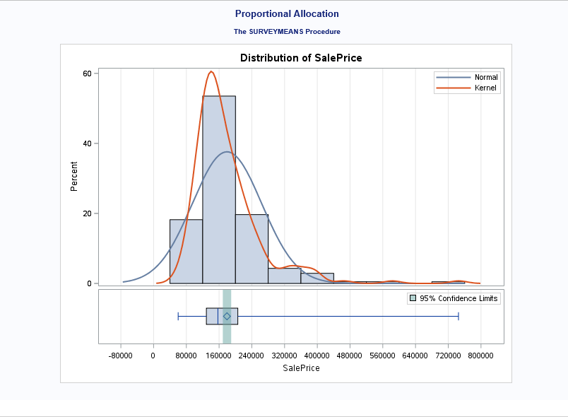
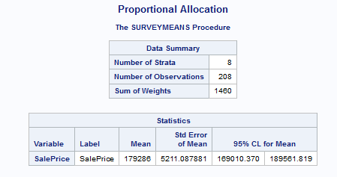
Design 2 (Contd..)
Sampling Results (Output from SAS)
Sample mean (x-bar) = 179,286
S.E of sample mean (s) = 5,211
95% C.I for sample mean = [169,010, 189,562]

Slide 8
Design 3: Stratified Sampling with Neyman Allocation
Another type of stratification method in which the variation of an auxiliary variable between strata are considered for determining the sample sizes for different strata to form the sample.
Stratum Sample Sizes
Stratum | House Style | No. Of Houses (Nh) | Average Gross Living Area | Std Dev Gross Living Area (sh) | Nh*sh | Sample Size (nh)
Stratum 1 | 1 Story | 726 | 1,309 | 381 | 276,606 | 92
Stratum 2 | 1.5 Fin | 154 | 1,565 | 445 | 68,530 | 23
Stratum 3 | 1.5 Unf | 14 | 896 | 110 | 1,540 | 0
Stratum 4 | 2 Story | 445 | 1,887 | 528 | 234,960 | 78
Stratum 5 | 2.5 Fin | 8 | 2,848 | 613 | 4,904 | 2
Stratum 6 | 2.5 Unf | 11 | 1,908 | 445 | 4,895 | 2
Stratum 7 | Sfoyer | 37 | 973 | 280 | 10,360 | 3
Stratum 8 | SLvl | 65 | 1,374 | 387 | 25,155 | 8
Total |  | 1,460 |  |  | 626,950 | 208

Slide 9
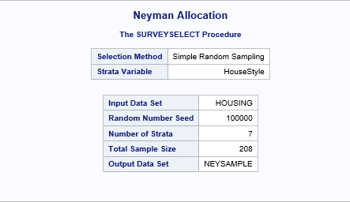
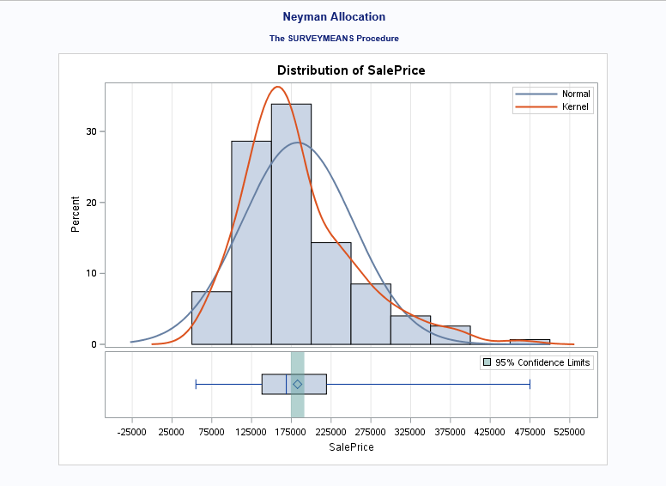
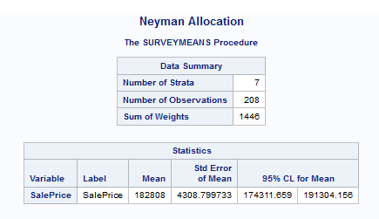
Design 3 (Contd..)
Sampling Results (Output from SAS)
Sample mean (x-bar) = 182,808
S.E of sample mean (s) = 4,309
95% C.I for sample mean = [174,312, 191,304]

Slide 10
Design 4: Two Stage Sampling
Two-stage sampling is a specific type of sampling design where population is segregated in several clusters based on a characteristic and a specific number of clusters are selected from all the clusters. These selected clusters are called Primary Sampled Units (PSU). In second stage, a further sampling is followed where samples are chosen from all selected clusters based on a sampling design. And sample units selected at this stage are known Secondary Sampled Units (SSU).
Design Structure
Total number of PSU - Neighborhood (M) = 25
Selected number of PSU (m) = 5
Number of population units in selected neighborhoods (N) = 141
N₁ = 16, N₂ = 17, N₃ = 9, N₄ = 74, N₅ = 25 where N_{i} = number of SSU in i^{th} PSU
Total sample size (n) = 28
Stratification based on ‘HouseStyle’ with proportional allocation, the sample sizes for 5 neighborhoods as follows:
n₁ = 1, n₂ = 15, n₃ = 8, n₄ = 3, n₅ = 1 where n_{i} = selected number of SSU from i^{th} PSU

Slide 11
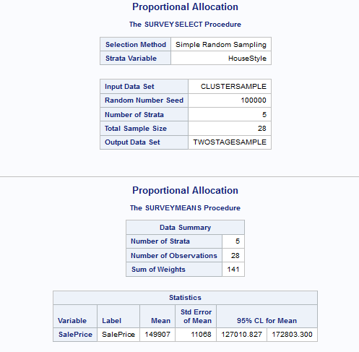
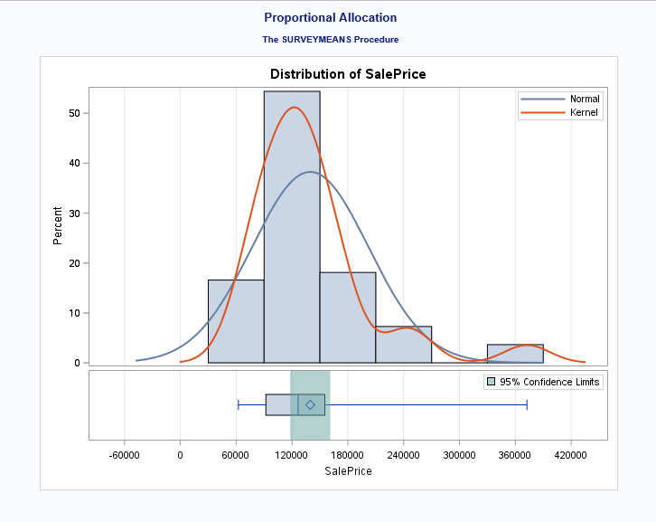
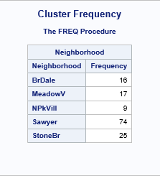
Design 4 (Contd..)
Sampling Results (Output from SAS)
Sample mean (x-bar) = 149,907
S.E of sample mean (s) = 11,068
95% C.I for sample mean = [127,010, 172,803]

Slide 12
Comparison between Sample Designs
Sample Designs | Sample Mean | Standard Error of Sample Mean | Confidence Interval | Design Effect
Simple Random Sampling | 177,378 | 5,099 | [167,325, 187,430] | -
Stratified Sampling (Proportional Allocation) | 179,286 | 5,211 | [169,010, 189,562] | 1.04
Stratified Sampling (Neyman Allocation) | 182,808 | 4,309 | [174,311, 191,304] | 0.71
Two-Stage Sampling | 149,907 | 11,068 | [127,010, 172,803]
Stratified sampling design with Neyman allocation results into the closest estimate (x-bar = 182,808) for population mean (μ= 180,921)
Stratified sampling design with Neyman allocation provides lowest standard error (s.e. = 4,309)
Stratified sampling design with Neyman allocation provides narrowest confidence interval (C.I = [174,311, 191,304])
Design effect for stratified design with proportional allocation = 1.04, indicates required sample size of 217 units to achieve an equal precision in estimation as compared to 208 in simple random sampling
Design effect for stratified design with Neyman allocation = 0.71, indicates 149 sample units are needed to achieve an equal precision as compared to 208 for simple random sampling

Slide 13
Task 2

Slide 14
Objective & Results
To select five random samples from our population of 1,460 houses for each of the four sampling techniques we use in Task 1 and count the number of samples for which the 95% confidence interval contain the population mean sale price of $180,921 for each sampling technique.
Design | Iteration | Mean | Standard Error | Lower 95% CL | Upper 95% CL | Percentage of CI's Containing Population Mean
Simple Random Sample | 1 | 175,784 | 4,614 | 166,689 | 184,880 | 80%
 | 2 | 187,675 | 5,572 | 176,690 | 198,659
 | 3 | 176,136 | 4,282 | 167,694 | 184,578
 | 4 | 169,466 | 4,013 | 161,555 | 177,377
 | 5 | 178,916 | 4,601 | 169,845 | 187,988
Proportional | 1 | 184,572 | 5,776 | 173,183 | 195,961 | 100%
 | 2 | 182,511 | 5,104 | 172,448 | 192,575
 | 3 | 188,214 | 5,180 | 178,000 | 198,428
 | 4 | 176,537 | 4,556 | 167,554 | 185,520
 | 5 | 186,368 | 5,344 | 175,831 | 196,906
Neyman | 1 | 188,179 | 5,111 | 178,100 | 198,257 | 100%
 | 2 | 181,245 | 5,092 | 171,204 | 191,286
 | 3 | 177,541 | 4,758 | 168,160 | 186,923
 | 4 | 184,498 | 4,910 | 174,816 | 194,180
 | 5 | 176,185 | 4,481 | 167,348 | 185,021
Two-stage (Cluster & Proportional) | 1 | 201,383 | 20,516 | 158,942 | 243,825 | 60%
 | 2 | 187,035 | 16,396 | 153,117 | 220,952
 | 3 | 137,012 | 8,782 | 118,844 | 155,180
 | 4 | 184,621 | 17,095 | 149,256 | 219,986
 | 5 | 139,561 | 8,519 | 121,938 | 157,184

Slide 15
Inferences
Design | Average Mean | Average Standard Error
Simple Random Sample | 177,595 | 4,616
Proportional | 183,640 | 5,192
Neyman | 181,530 | 4,871
Two-stage (Cluster & Proportional) | 169,922 | 14,262
Mean of average house sale prices under SRS based on 5 samples is more than $3,000 lower than the population mean
Stratified sampling with proportional allocation estimates mean of average sale prices which is almost $2,000 above population mean
Stratified sampling with Neyman allocation comes the closest in predicting the population mean with an sample average of $181,530 across the five samples, merely $609 higher than population mean
SRS method has the lowest average standard error at $4,616 while the Neyman method comes in second at an average of $4,871
80% of the confidence intervals for sample mean under SRS capture the population mean whereas stratified sampling captures it in all cases
Confidence intervals for sample mean fails to contain population mean in 40% cases for two stage design
Overall Stratification following Neyman allocation produces the perfect balance between accuracy (minimal bias) and precision (minimal variance)

Slide 16
Thank You

